Slide 1

AOLME Curriculum SESSION 1
MATERIALS DEVELOPED BY THE AOLME PROJECT AT THE UNIVERSITY OF NEW MEXICO, PLEASE DO NOT COPY OR DISTRIBUTE ANY OF THESE COPYRIGHTED TASKS WITHOUT PROPER AUTHORIZATION OF PROJECT

Slide 2


Level 1
SESSION 1: Basic of Raspberry PI and Linux-(motivational overview of projects-images, ls, cd, to find previously made files) SESSION 2: Introduction to Python (print, for, if) SESSION 3: Algorithms (for loops-arithmetic progressions, if statements-ranges, inequalities) SESSION 4: The Coordinate Plane and Black & White Images in Python SESSION 5: Binary and Hexadecimal number systems SESSION 6: Images and Their Components (histograms) SESSION 7: Creation of Images and Video FINAL PROJECT: VIDEO

Slide 3
Basics of Raspberry PI and Linux
Goals:
Explore, identify, and name a computer’s components across systems (PC and Raspberry).
Describe how information flows in a computer system.
Utilize basic Linux commands to navigate filesystems in a Raspberry Pi.
Practice assembling components and cables of a computer system.

Slide 4

Selected ACTIVITIES
1. Components of a computer and the Raspberry Pi
2. Assembly of the Raspberry Pi components and internal data flow in Computers
3. Navigation of directories and basic commands in Linux

Slide 5

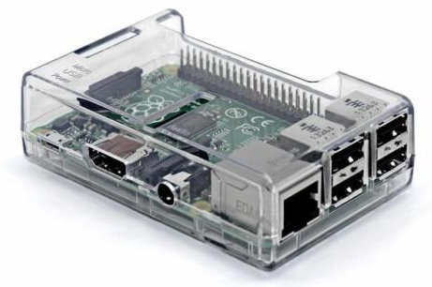
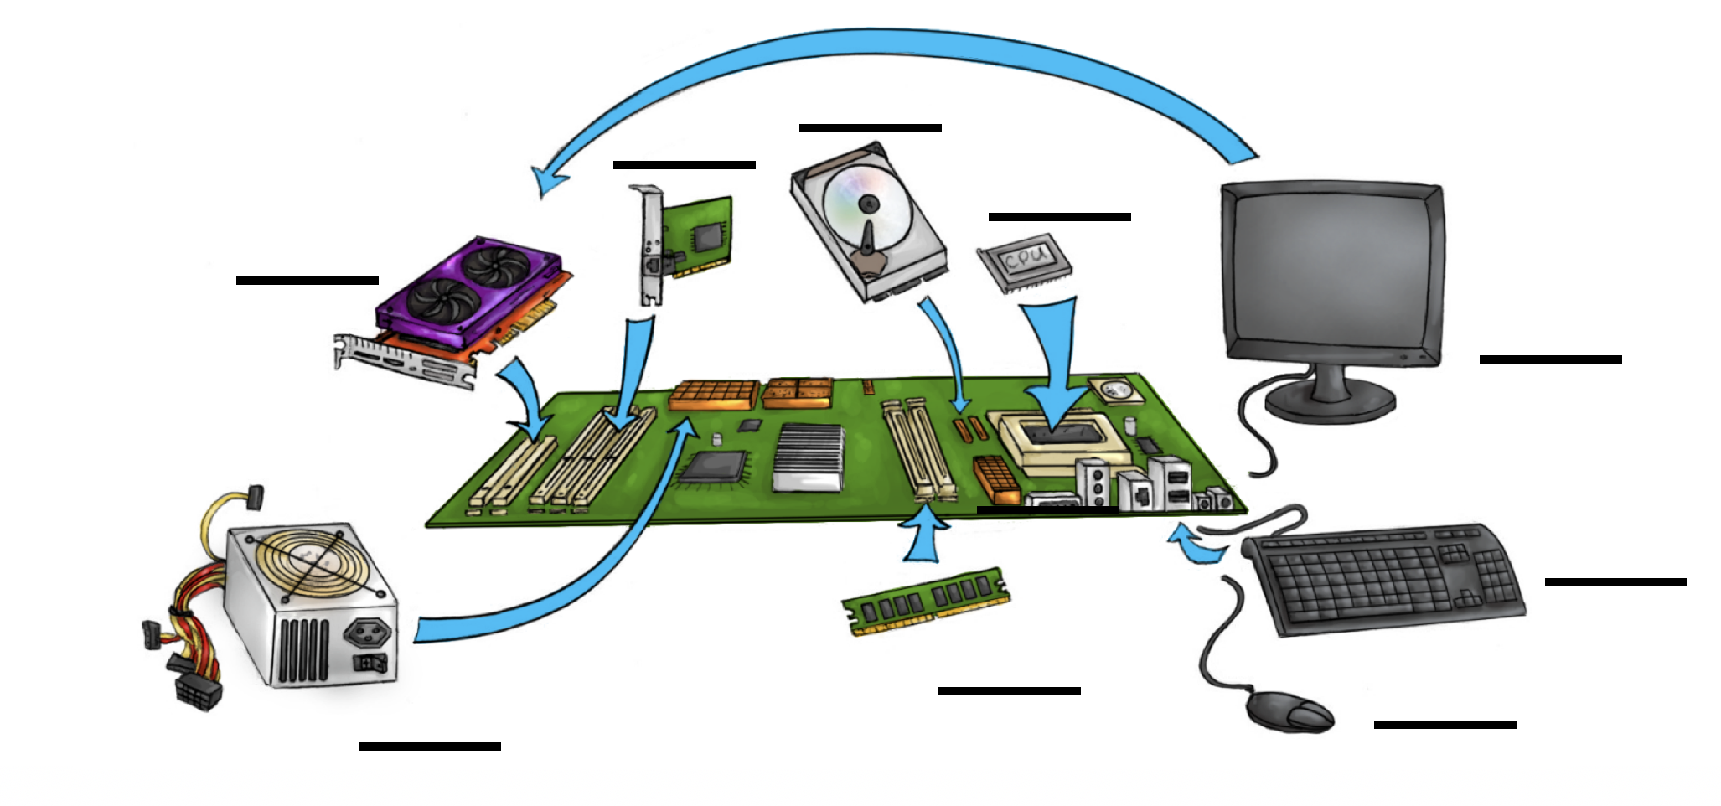
1.1. Components of a Computer & the Raspberry Pi
Think & Talk: What do you know about computers? What do you think a Personal Computer (PC) is? What’s a Raspberry Pi? What are the components or parts of a computer?
ID the parts: In your team, place the white cards on table and take turns naming the parts of the computer you know. Try to separate the components that belong to a PC or a Raspberry Pi.
3. Play: (a) Organize the cards in columns by color and match the ones that go together. Note: green cards = component names; yellow cards = descriptions, & white cards = visuals.
(b) Sort all cards in 2 piles by computer system PC or R Pi. Then, play memory game using the cards for a system. Create your game rules. Work together using the cards.
4. Identify: In your team take turns using a real Raspberry Pi and a PC and identify the components by name and match the parts with similar functions in each computer.
What is important to remember about each system?
AOLME PROJECT - LEVEL 1- SESSION 1- 2019
MATERIALS DEVELOPED BY THE AOLME PROJECT AT THE UNIVERSITY OF NEW MEXICO, PLEASE DO NOT COPY OR DISTRIBUTE ANY OF THESE COPYRIGHTED TASKS WITHOUT PROPER AUTHORIZATION FROM THE PROJECT

Slide 6
Components of a Computer
RAM
Random Access Memory
GPU
Graphics Processing Unit
Hard drive
PC
Camera
Power Supply for Personal Computer (PC)
Ethernet Port
Ethernet card for Personal Computer (PC)
CPU
Central Processing Unit
Portable Power Supply (para R Pi)
Secure Digital
(SD)
Memory Card
Motherboard
Raspberry Pi Camera
AOLME PROJECT - LEVEL 1- SESSION 1- 2019
MATERIALS DEVELOPED BY THE AOLME PROJECT AT THE UNIVERSITY OF NEW MEXICO, PLEASE DO NOT COPY OR DISTRIBUTE ANY OF THESE COPYRIGHTED TASKS WITHOUT PROPER AUTHORIZATION
Notes:
Reduce number of codes P
Provide examples of images and how they were pixelated

Slide 7
Components of a Computer
Stores program files and data. Everything stays here even if the computer is turned off. This is used as permanent storage for the data.
It is used to store all programs and data that will be processed by CPU. When the computer is turned off, the memory is lost.
It is used to process data fast. It reads its data from the RAM and writes the results to the RAM when done.
It connects to the computer externally. It is used by the computer to take pictures.
This is a connector. You can plug a cable into it so a computer can access the internet.
It supplies power to the different Personal Computer (PC) components.
It is used to store data securely. The data are not lost when the device is turned off. It can be used in several systems.
This is the brain of the computer. It tells everyone else what to do. It also performs mathematical operations
It is used to supply power to small computers (e.g., Raspberry Pi) or a mobile phone.
It is used to connect the CPU to the memory, the power, and all other computer components together.
It is used to connect a Personal Computer (PC) to the internet.
It connects to the Raspberry Pi computer. It is then used to take pictures.
AOLME PROJECT - LEVEL 1- SESSION 1- 2019
MATERIALS DEVELOPED BY THE AOLME PROJECT AT THE UNIVERSITY OF NEW MEXICO, PLEASE DO NOT COPY OR DISTRIBUTE ANY OF THESE COPYRIGHTED TASKS WITHOUT PROPER AUTHORIZATION
Notes:
Reduce number of codes P
Provide examples of images and how they were pixelated

Slide 8
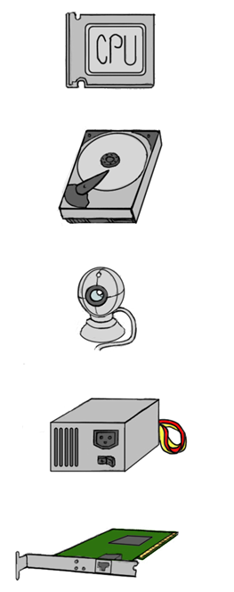

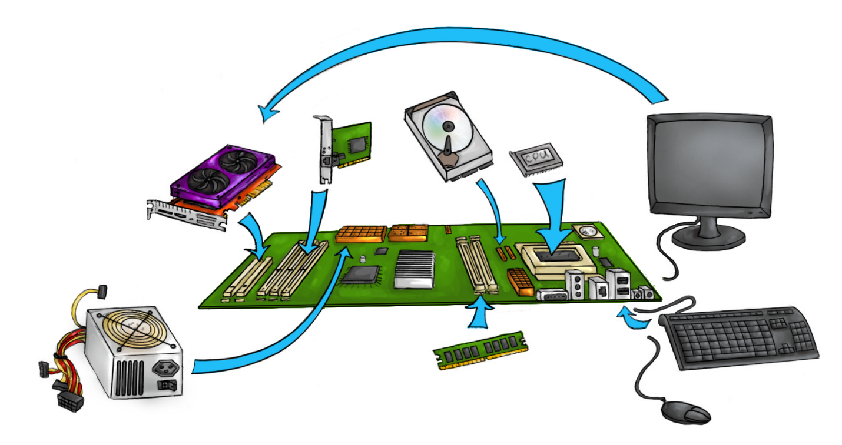
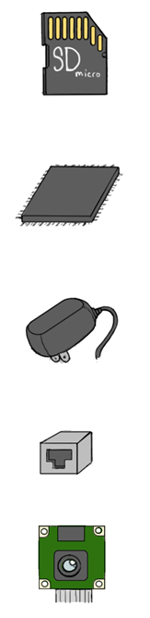

Components of a Computer
AOLME PROJECT - LEVEL 1- SESSION 1- 2019
MATERIALS DEVELOPED BY THE AOLME PROJECT AT THE UNIVERSITY OF NEW MEXICO, PLEASE DO NOT COPY OR DISTRIBUTE ANY OF THESE COPYRIGHTED TASKS WITHOUT PROPER AUTHORIZATION
Notes:
Reduce number of codes P
Provide examples of images and how they were pixelated

Slide 9
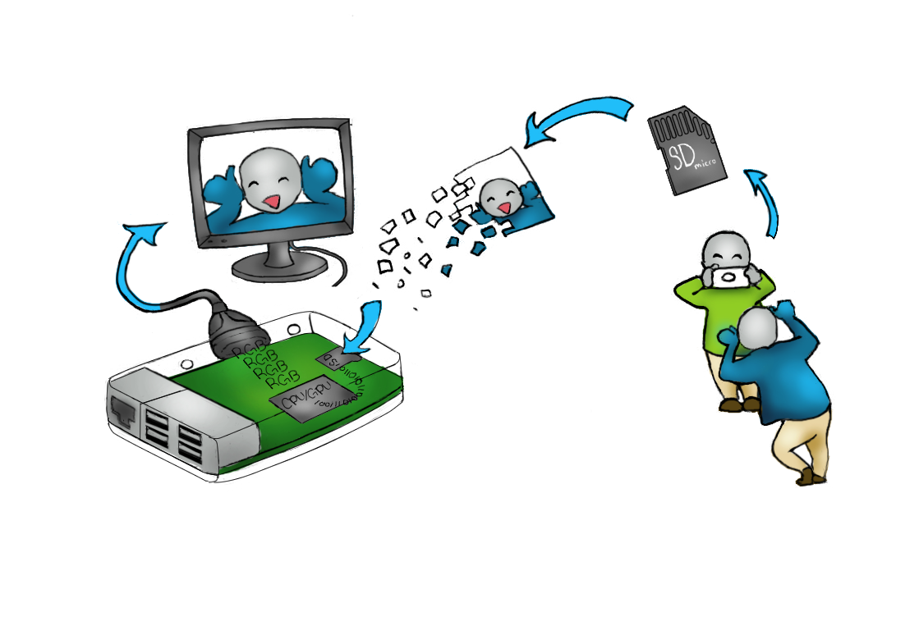

1.2. Computer Components and Data Flow
Think of another example of data flow
1. Think & Talk: What do you notice in the picture about the flow of data across the computer components? Explain using the picture.
2. Think, Talk, & Do: With your team members take turns putting together the Raspberry Pi computer. As you do, name the components you assemble or connect. -What is you favorite part? Why? -What component is linked to the HDMI connector?
REMEMBER! Connect the power last.
AOLME PROJECT - LEVEL 1- SESSION 1- 2019
MATERIALS DEVELOPED BY THE AOLME PROJECT AT THE UNIVERSITY OF NEW MEXICO, PLEASE DO NOT COPY OR DISTRIBUTE ANY OF THESE COPYRIGHTED TASKS WITHOUT PROPER AUTHORIZATION

Slide 10


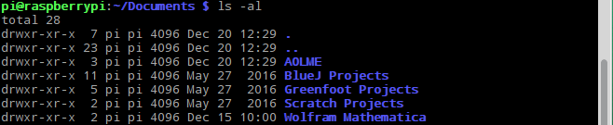
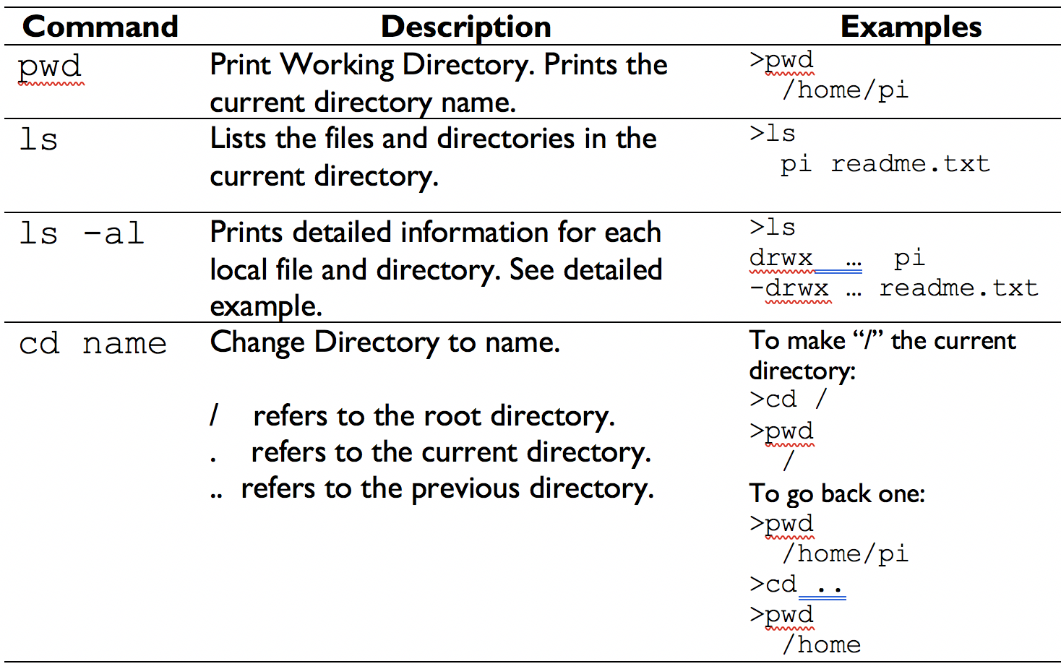
1.3.1. Linux Commands to Navigate the File System
Explore: The Graphical User Interface or GUI helps us surf the file system by clicking on icons. Open and close 2-3 files.
2. The icons or GUIs are for us. Computers work with commands. To learn some commands, open the Terminal in Linux by clicking on: Start by typing ls -al and click enter. You will see something like:
Open a directory using the GUI File Manager by clicking on the folder icon. The taskbar appears on the left-top side of your monitor. Have you ever used GUIs? What’s a directory? Is a folder a directory? Why? How different are files from directories?
Look! If the line starts with “d” it’s a directory. If it were “-” then it’d be a file. The text at the end (blue here) is the file or directory name.
What else do you see?
3. Work: Taking turns, try out these commands. Discuss what happens
4. Challenge:
Find how many directories there are in your computer under /home/pi Use only commands and NOT the GUI!
Hint: Start using:
cd /home/pi
ls –al
Another way to see the directories is: the tree command. For this in the terminal type: cd /home/pi
tree
Describe, what’s a command?
What’s a root directory?
How do you think these two lines connect?
AOLME PROJECT - LEVEL 1- SESSION 1- 2019
MATERIALS DEVELOPED BY THE AOLME PROJECT AT THE UNIVERSITY OF NEW MEXICO, PLEASE DO NOT COPY OR DISTRIBUTE ANY OF THESE COPYRIGHTED TASKS WITHOUT PROPER AUTHORIZATION

Slide 11
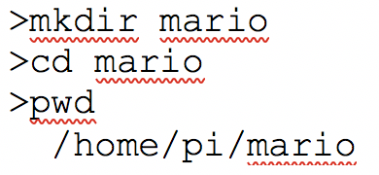
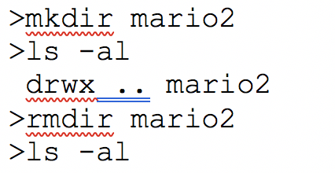

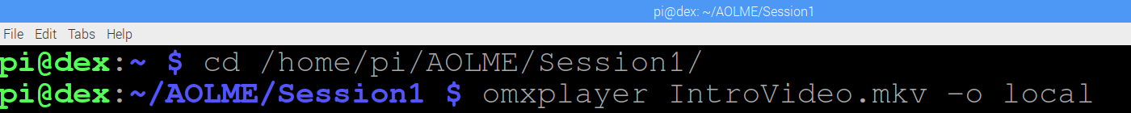
1.3.2. Linux Commands to Work with Directories
Keep using the Terminal:
Create directories using this command:
mkdir name
Remove or erase directories using this command:
rmdir name
Write & Run these commands. What does each line do? Why do you think that?
Write & Run these commands. What does each line do? Why do you think that?
LOL! So, to use cd first we need to mkdir!
Instead of ‘mario’ use other names
Be careful: Once you remove a directory, you cannot recover the files in that directory.
3. Challenge 1:
With your team, create 3 directories:
/home/pi/try1,
/home/pi/try2, and
/home/pi/try3.
Then, erase them all.
4. Challenge 2: Now that you can navigate directories, open & watch a video. Open the Terminal and access the
Session 1 folder, and type in commands below.
Note: Folder levels to navigate:
/home/pi/AOLME/Session1/
The name of video is: IntroVideo
Write: What Linux commands should you remember? How can you tell the directory levels? What do these codes do?
AOLME PROJECT - LEVEL 1- SESSION 1- 2019
MATERIALS DEVELOPED BY THE AOLME PROJECT AT THE UNIVERSITY OF NEW MEXICO, PLEASE DO NOT COPY OR DISTRIBUTE ANY OF THESE COPYRIGHTED TASKS WITHOUT PROPER AUTHORIZATION

